Slide 1
Coffee and Productivity
The-Confabulators

Slide 2


Background
On an individual level, consumption of coffee and its active ingredient, caffeine (a stimulant), is associated with higher levels of “energy” and “productivity”. But in a given population, such as a nation-state, does higher coffee consumption indicate a higher level of productivity?

Slide 3
Contents
Total Coffee Consumption by Country
Coffee Consumption per Capita by Country
Productivity (GDP per hour worked) Trend by Country
Top Coffee Drinking Countries and Top Productivity Counties?
Coffee Consumption Productivity by Year
Correlation Between Coffee Consumption and Productivity
Hypothesis Test: Can We Reject Null-Hypothesis(H0)?

Slide 4
Data Exploitation and Data Cleaning
Coffee Data: ICO (International Coffee Organization)
Productivity Data: OECD (Organisation for Economic Co-operation and Development)
Population Data: Kaggle.com
Show DATA CLEANING CODE
https://github.com/mosleykc/Confabulators_Project_1/blob/Michael/data/data_cleanup.ipynb
HERE

Slide 5
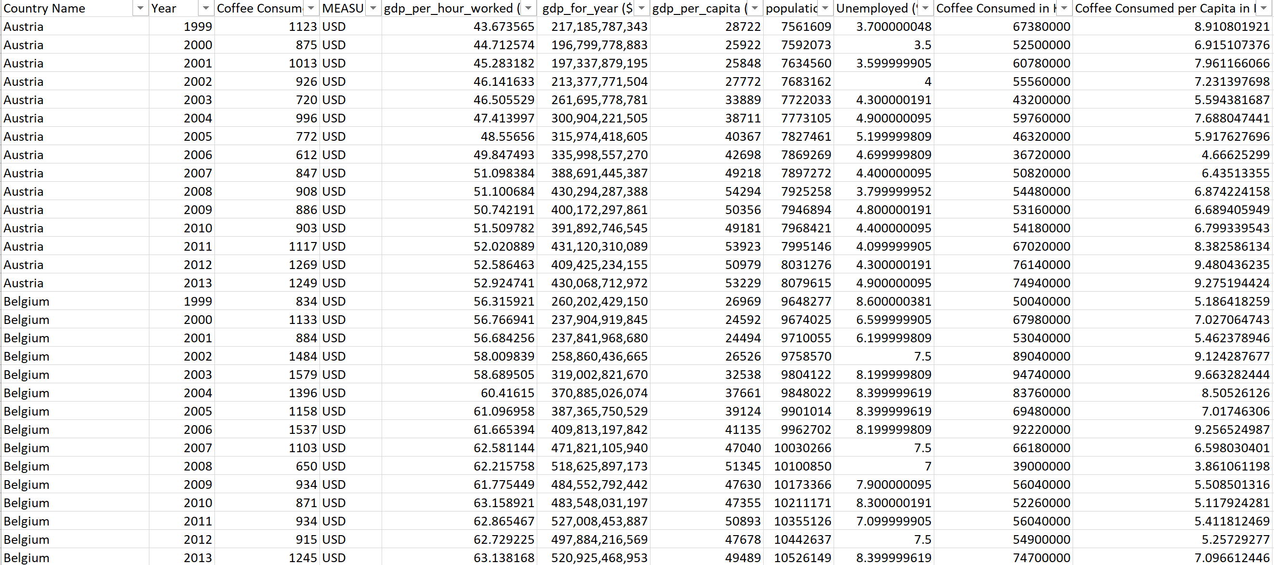
Dataset ready!

Slide 6
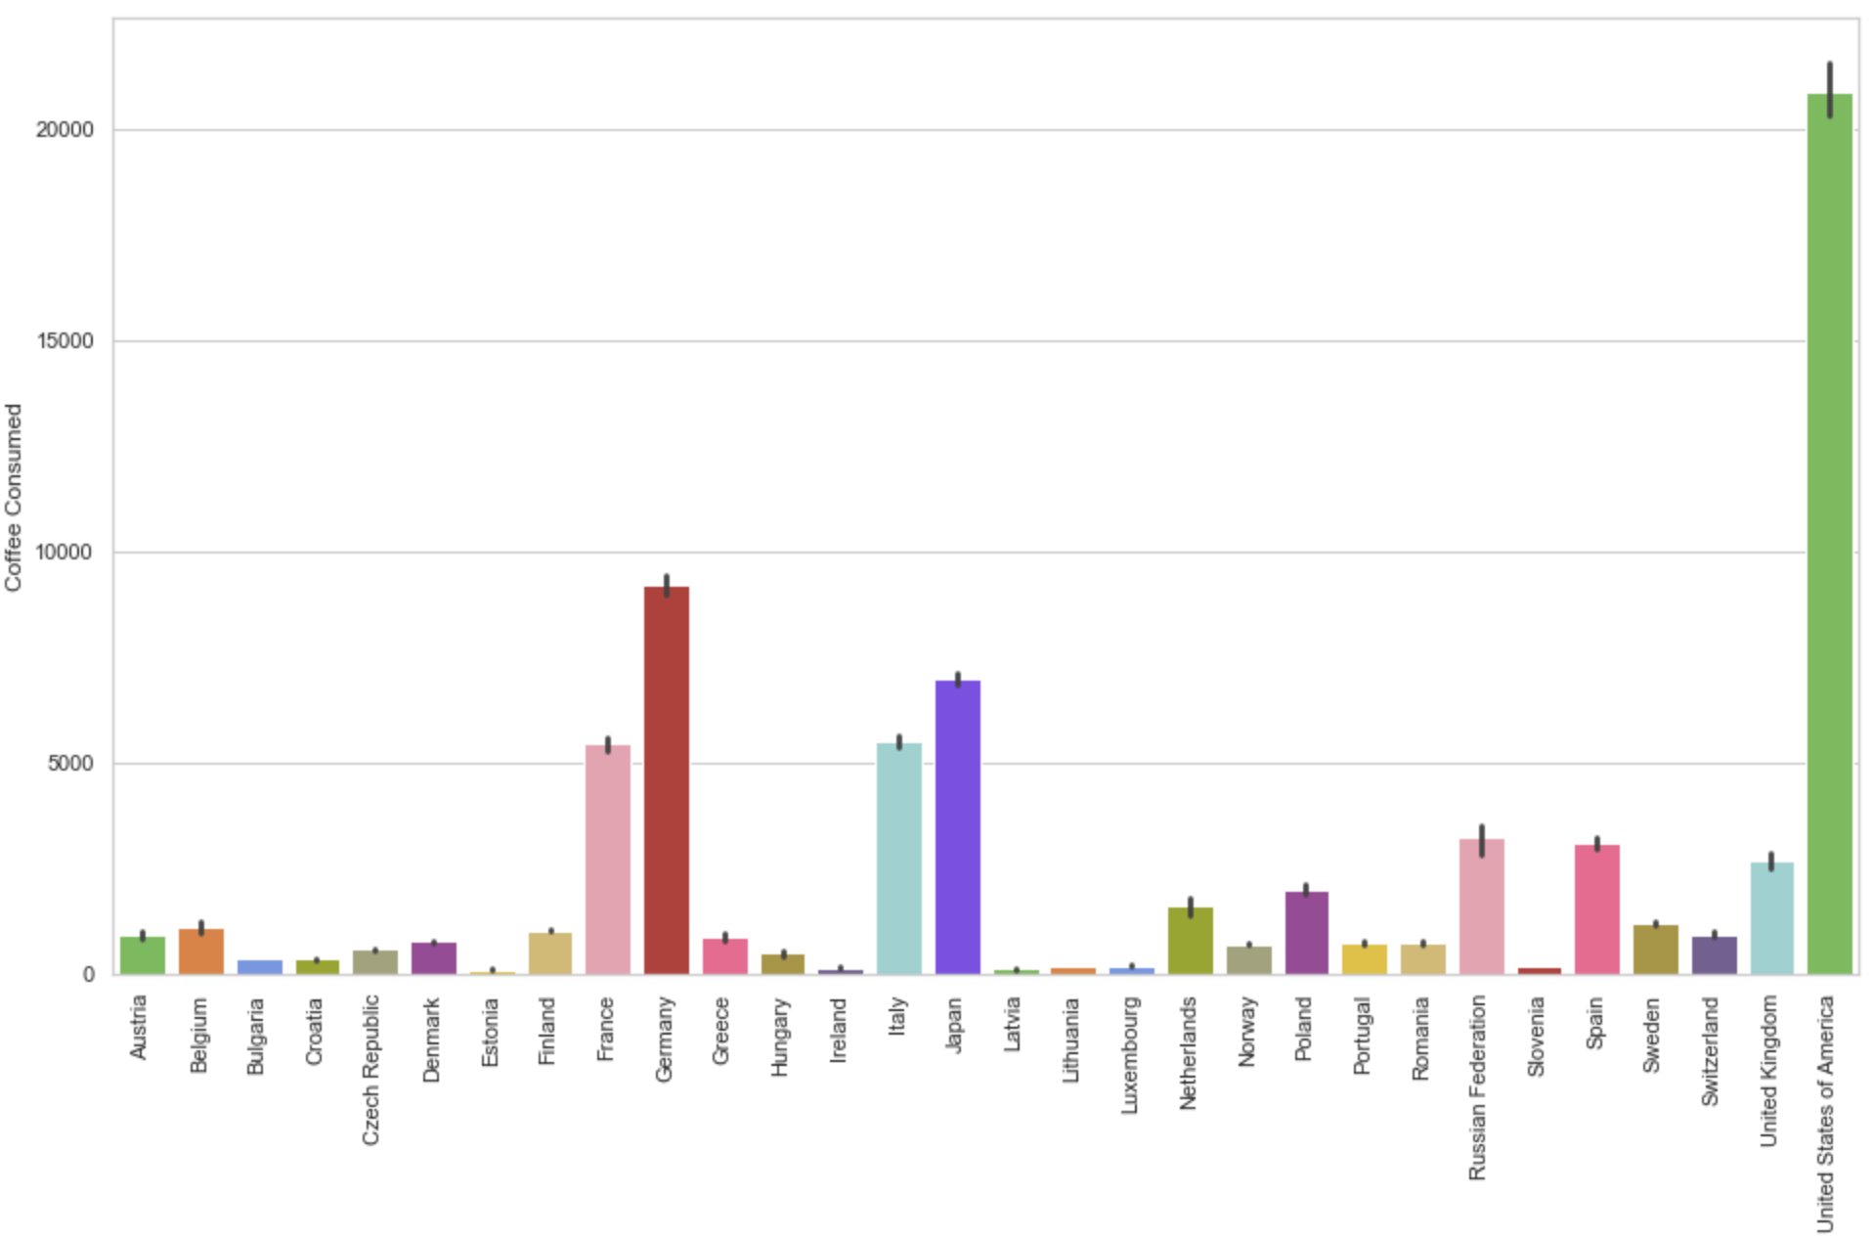
Total Coffee Consumption by Country
* World largest Coffee Drinking Countries are USA, Germany and Japan, Italy, and France

Slide 7
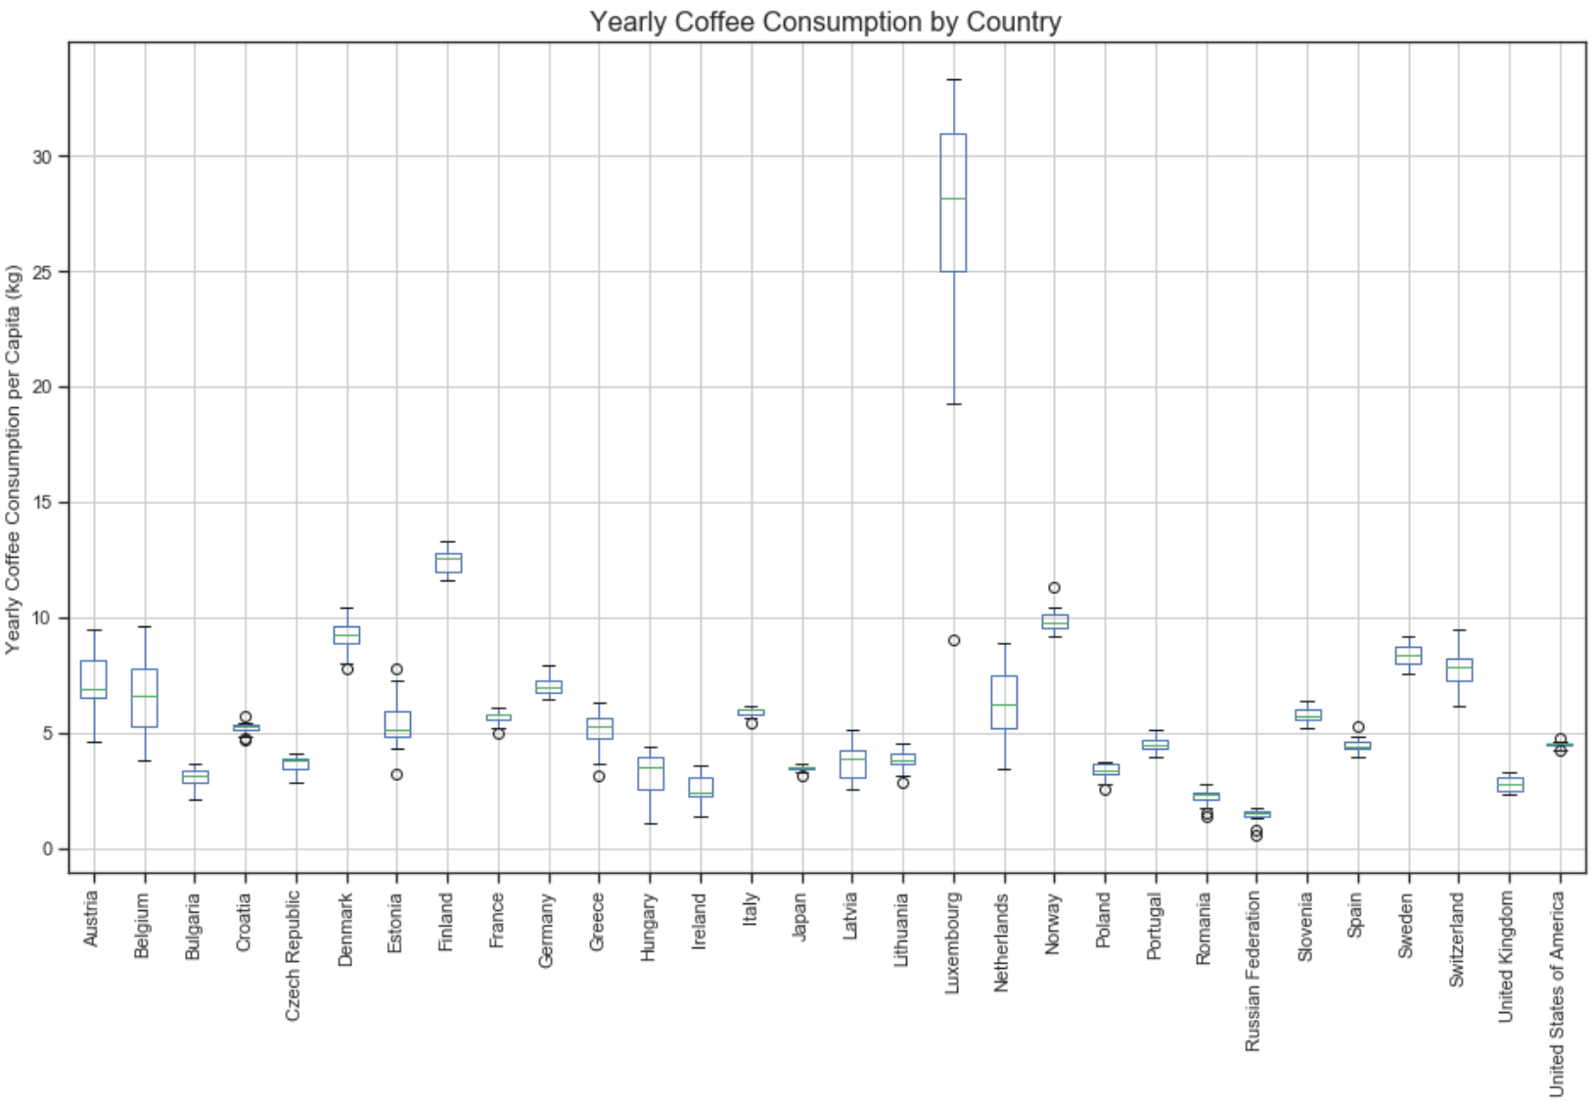
Coffee Consumption per Capita by Country (from 2000 to 2013, 15 years, mean)
* Top Coffee Drinking Countries per Capita are Luxembourg, Finland, Normay, Denmark, and Sweden

Slide 8
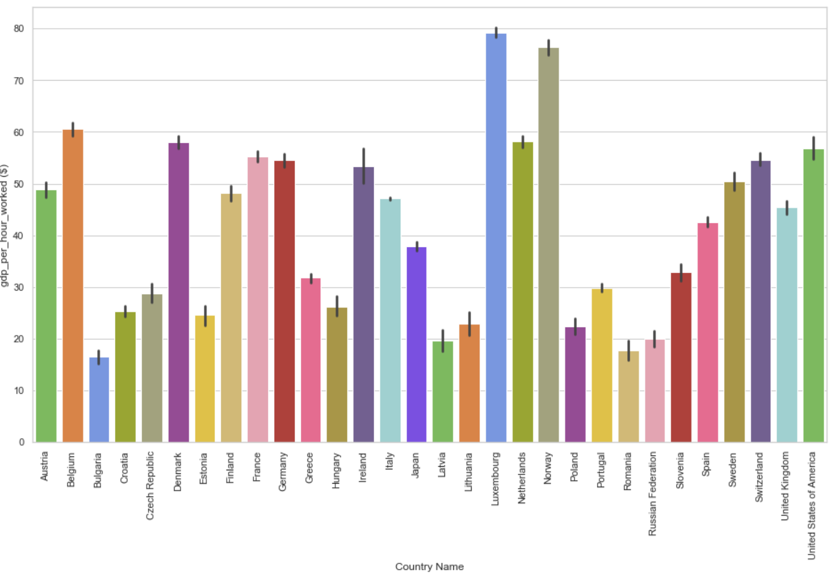
Productivity Trend by Country
Productivity is measured by GDP(Gross Domestic Product) by hour per worked.
Growth in labour productivity indicates a higher level of output for every hour worked)

Slide 9
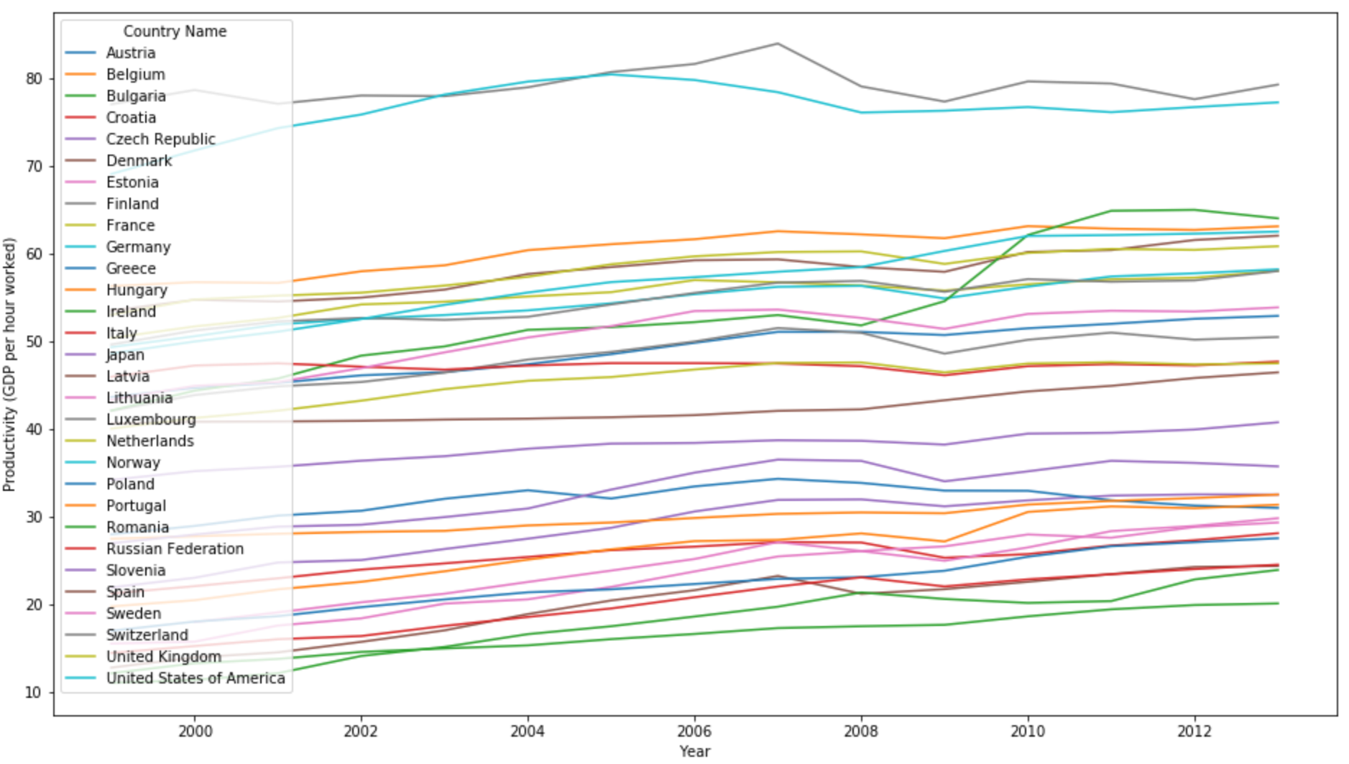
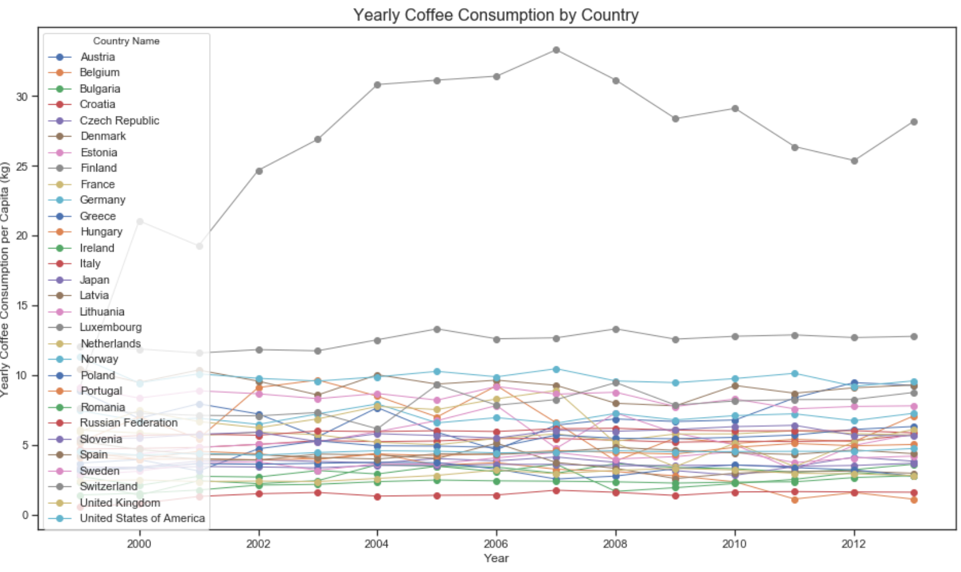
Coffee Consumption and Productivity by Year

Slide 10
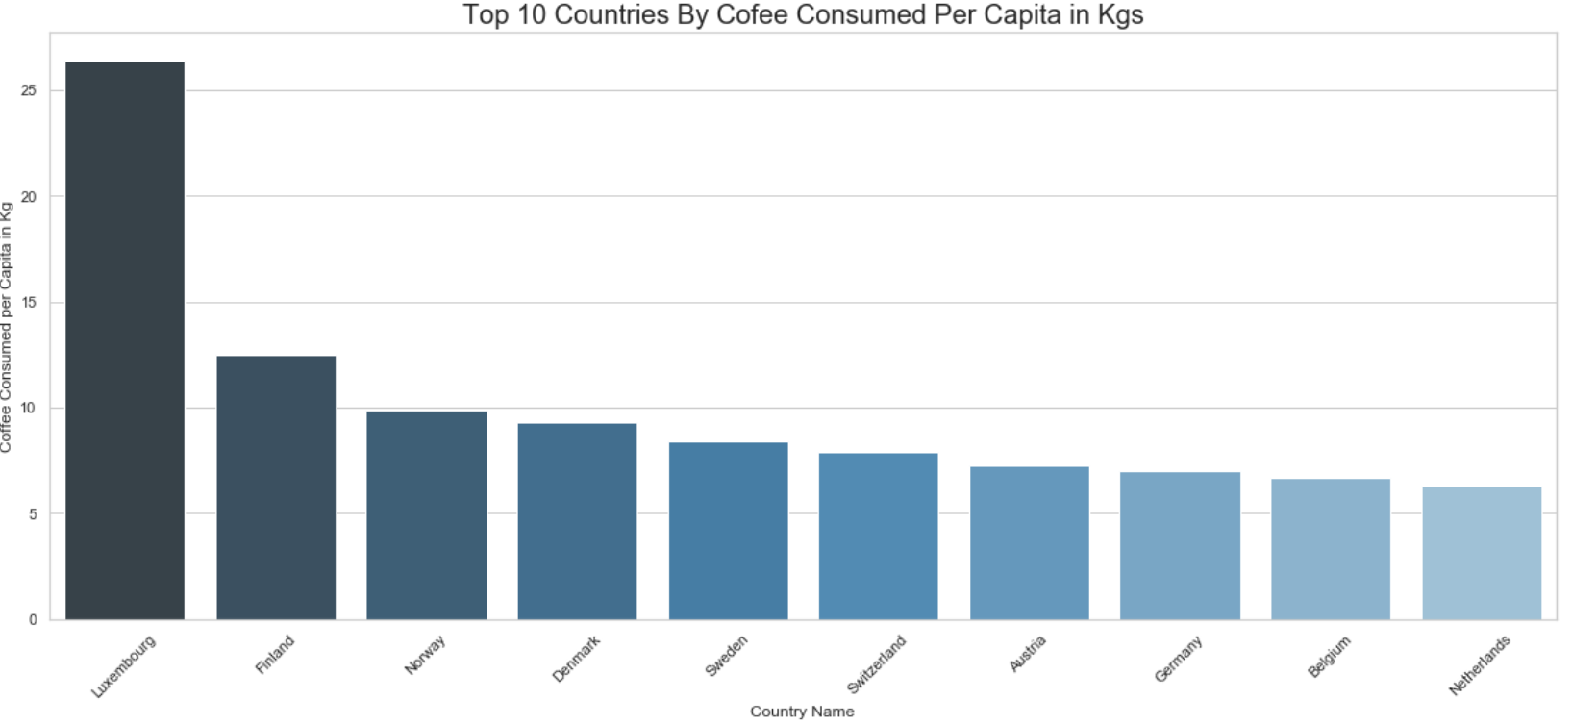
Top Coffee Consuming Countries (per capita)

Slide 11
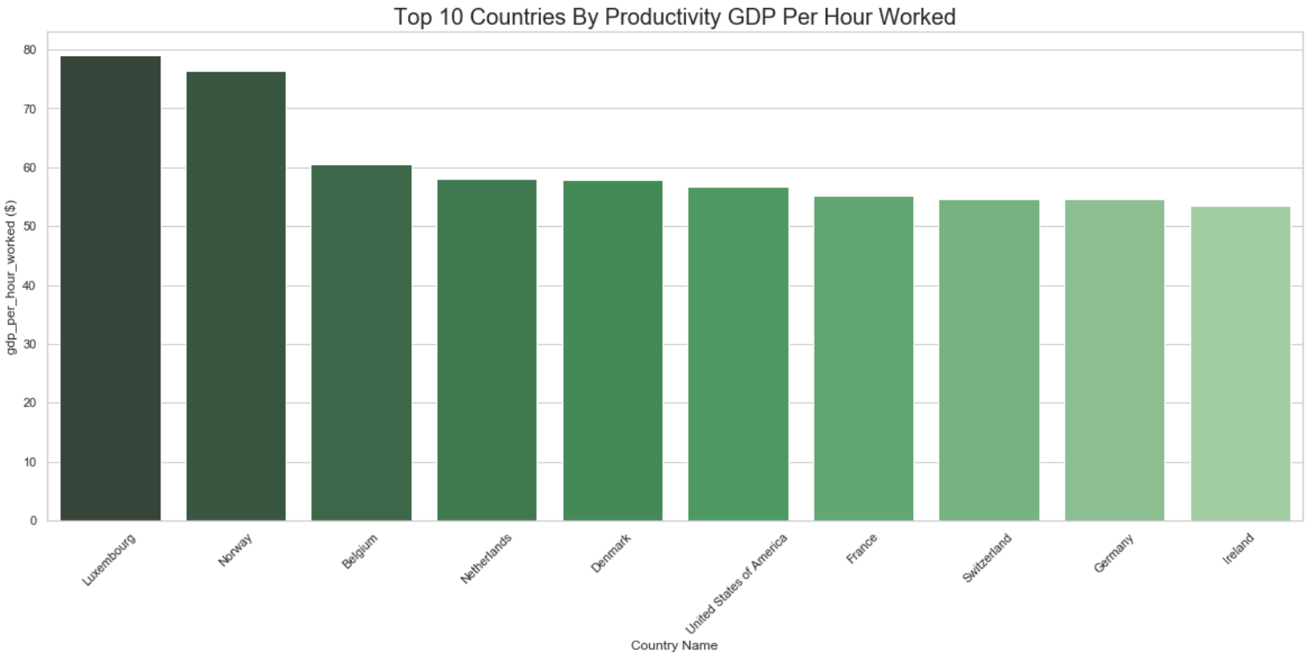
Top Productivity Countries (GDP per hour worked)

Slide 12
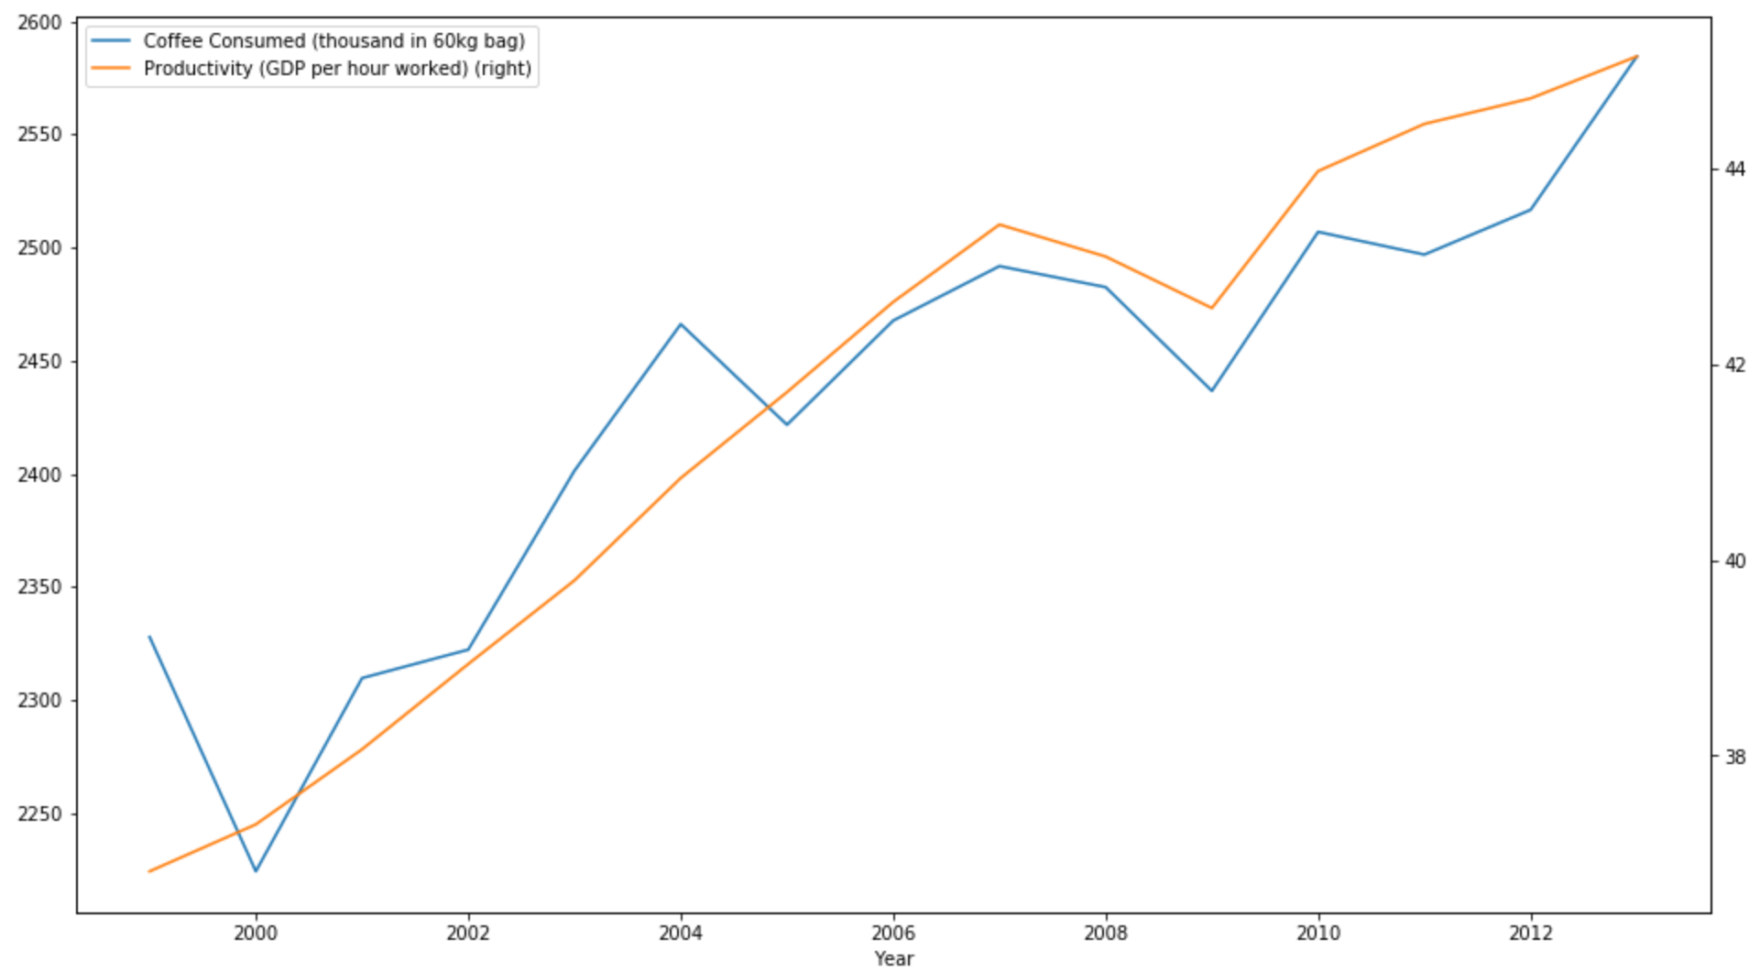
Overall Trend: The Mean of Coffee Consumption and the Mean of Productivity by Year (Together)

Slide 13
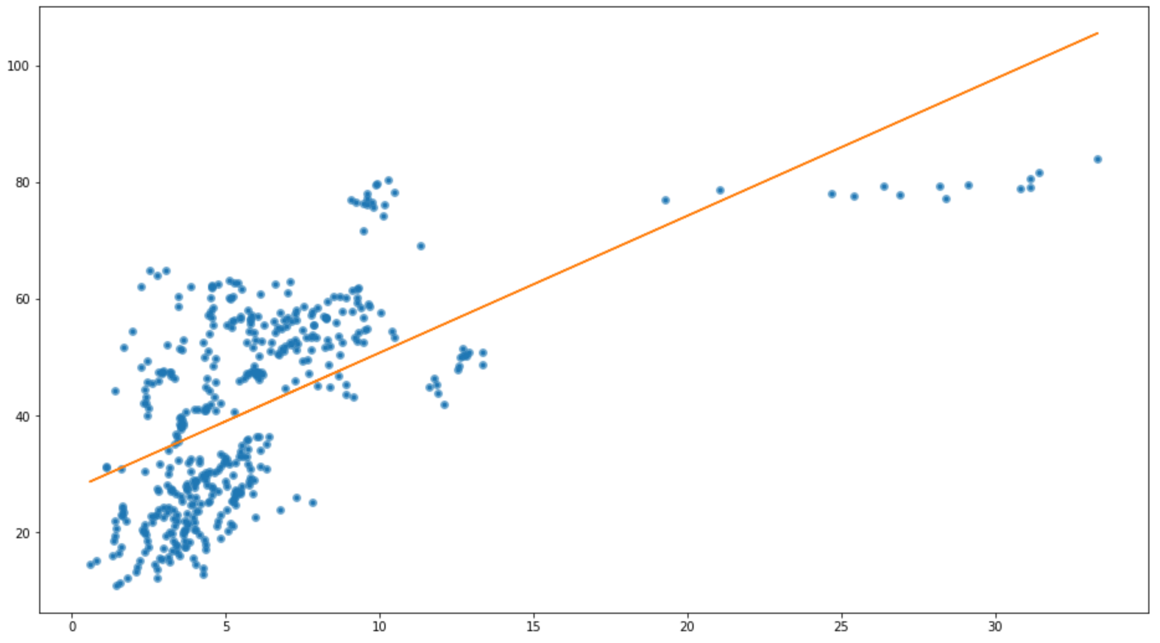
Correlation Between Coffee Consumption and Productivity

Slide 14
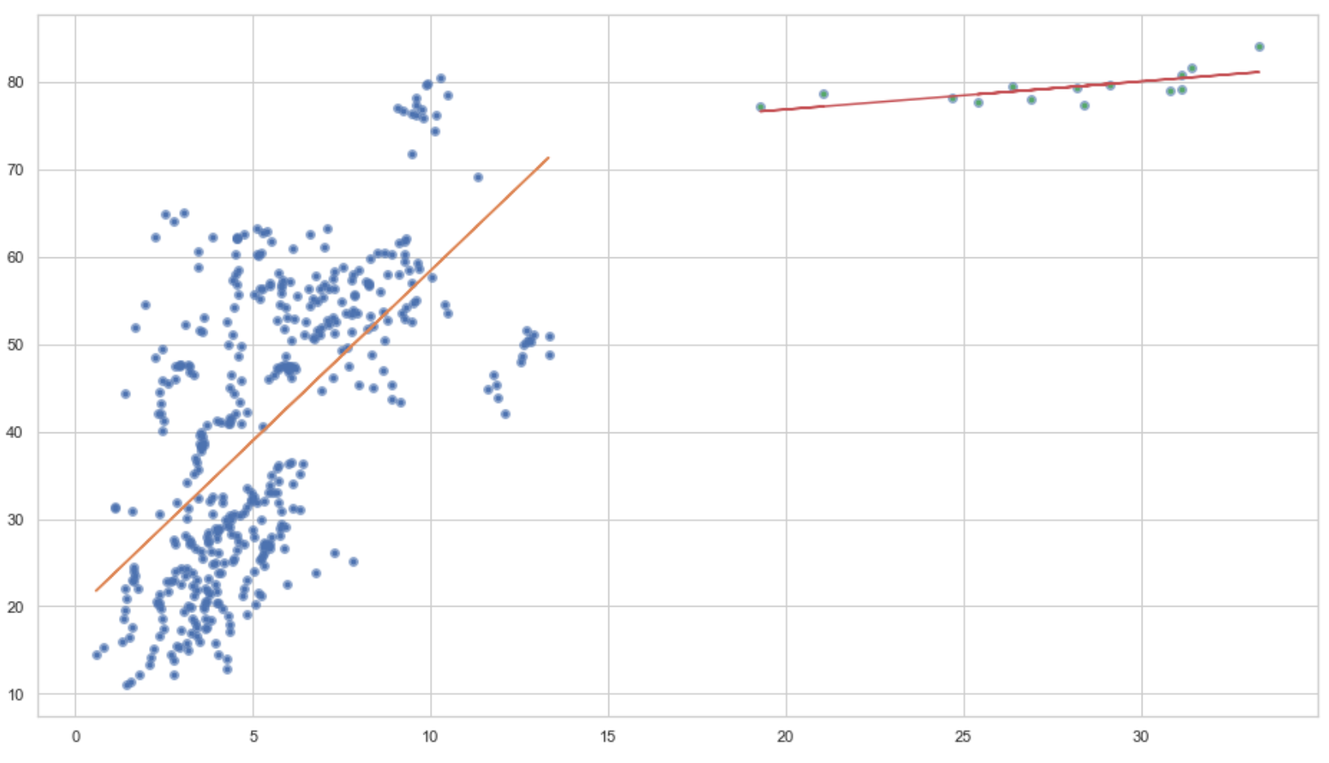
Correlation Between Coffee Consumption and Productivity (more precise)

Slide 15
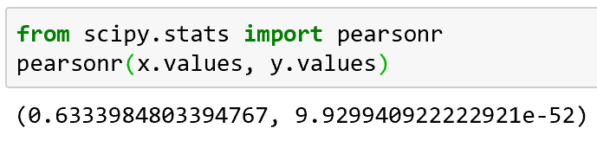
Hypothesis Test: Can We Reject Null-Hypothesis(H0)?
Correlation coefficient
P-value
p-value is < 0.05
We Reject Null-Hypothesis.
Drinking Coffee and Higher Productivity is correlated!

Slide 16
Conclusions
The biggest coffee market is the United States, Germany, Japan, France, Italy
The top coffee drinkers per capita live in Luxembourg, Finland, Norway, Denmark, Sweden
High Productivity (work effective) countries are Luxembourg, Norway, Belgian, Netherland, Denmark
Amount of coffee consumed and higher productivity measured as GDP per hour worked are correlated.
Consuming coffee less than 15 kg (33 lbs) per capita has stronger correlation but consuming larger than 15 kg per capita shows weaker correlation.

Slide 17
